Slide 1

Microsoft Movie Studios Genre Recommendations
Author: Tahron Herring
November 18, 2022

Slide 2

Overview The technology giant, Microsoft is looking to expand it's lines of business by jumping into the movie business. This project will analyze data from various movie tracking and rating companies to help them determine how to best direct project investments that help ensure a successful start to this venture.

Slide 3
Outline
Business Understanding
Data Understanding
Analysis Results
Conclusions

Slide 4
Business Understanding
Goal: Guide Microsoft Movie Studios film development decisions
Need to determine which films currently perform the best at the box office
Analytics Metric: Film Popularity
Analytics Metric: Film Profitability

Slide 5


Data Understanding
Popularity Datasources
Profitability Datasources
IMDB
Rotten Tomatoes
The Movie Database
Box Office Mojo
The Numbers

Slide 6
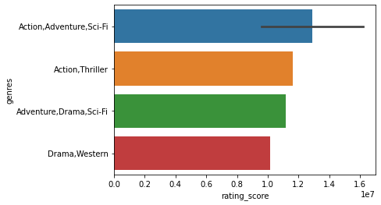
Analysis Results
IMDB Results : Top 5 movie genres based on popularity

Slide 7
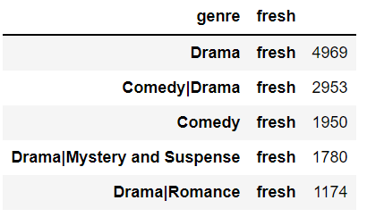
Analysis Results
Rotten Tomatoes Results : Top 5 movie genres based on popularity

Slide 8
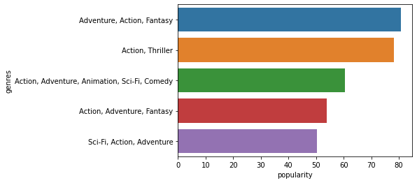
Analysis Results
The Movie DB Results : Top 5 movie genres based on popularity

Slide 9
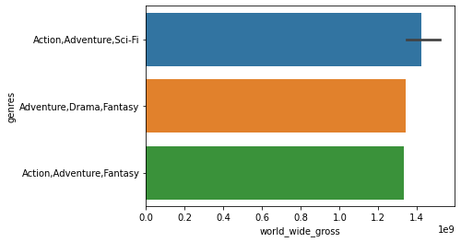
Analysis Results
Box Office Mojo Results : Top 5 most profitable movie genres

Slide 10
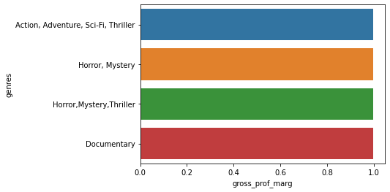
Analysis Results
Box Office Mojo Results : Top 5 most profitable movie genres

Slide 11
Conclusions
Recommendations:
Focus on producing Action Films - In our genre ranking system Action ranked highest in popularity and came in second for profitability.
Focus on producing Adventure Films - For the Adventure genre it ranked second in popularity and first in profitability.
Focus on producing Sci-Fi Films - The Sci-Fi genre ranked 4th and 3rd in popularity and profitability.
Next Steps:
Increase the top sample size for analysis
Use different analysis methods
Expand the datasources used

Slide 12
Contact Information
Email: Tahron.Herring@gmail.com
GitHub: @Tmoney80
LinkedIn: linkedin.com/in/tahronherring/

